Slide 1
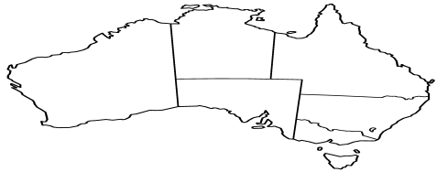
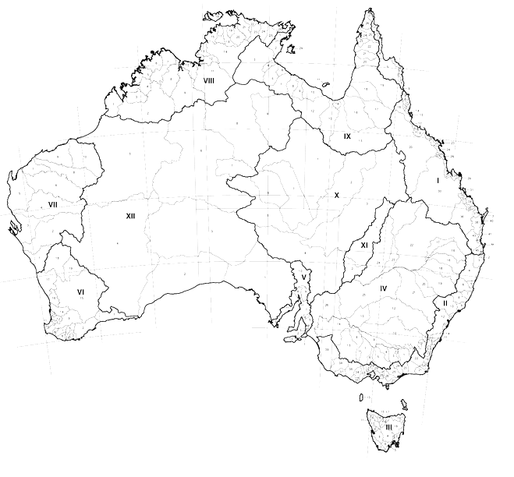
FSDF
Hierarchical Relationship:
- e.g., NSW (State) is parent to Albury (LGA)
Jurisdictional Units
Topology
+
Spatial Relationship
Local Government Units
Spatial Relationship
– e.g. NSW (State) is “adjacent” to Towong (LGA)
Spatial Relationship
– e.g. Towong (LGA) “intersects” Yackandandah (SA2)
Statistical Units
Geometrical
Representation
PSMA
ABS
Geometry Data

Slide 2
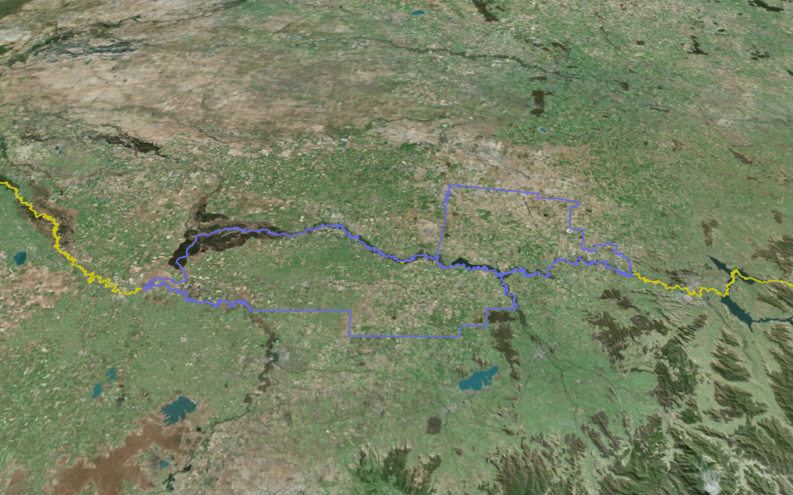
STATE
(NSW)
LGA Y (Corowa)
LGA X
(Moira)
STATE
(VIC)
Adjacent:
LGA X adjacent to LGA Y
State NSW adjacent to State VIC
LGA X adjacent State NSW

